Slide 1
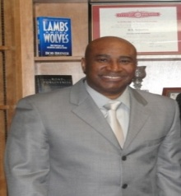
FIRST BAPTIST CHURCH
DR. D.L. RICHARDSON, PASTOR
Get Connected
CONQUERING COMMUNITIES FOR CHRIST
FAITH VISION 2016

Slide 2
I Got Connected at FBC with…
Celebratory
Worship
Christ-Centered
Discipleship
Get Connected
Compassionate
Ministry
Christian
Fellowship
Community
Evangelism

Slide 3
Get Connected with...
WORSHIP
WORD
Our Goal is to…
Get Connected
WOUNDED
WHOLENESS
WITNESSING

Slide 4
Celebratory Worship

Slide 5
Celebratory Worship

Slide 6
Celebratory Worship

Slide 7
Christ-Centered Discipleship

Slide 8
Christ-Centered Discipleship

Slide 9
Christ-Centered Discipleship

Slide 10
Community Evangelism

Slide 11
Community Evangelism

Slide 12
Christian Fellowship

Slide 13
Christian Fellowship

Slide 14
Christian Fellowship

Slide 15
Compassionate Ministry

Slide 16
Compassionate Ministry

Slide 17
Compassionate Ministry

Slide 18
Playing Field
Hit a HOMERUN . . . Embrace the Vision
Ministry Leaders
2
Vision
Vision
Communication
Communication
Jesus
Christ
Deacons
Membership
3
1
Communities are conquered
Communication
HOMERUN!
“The
Ball has
been hit”
HB
Pastor
Notes:
SLIDE #2
“The Playing Field” is a direct response to the President Bush’s emphasis in promoting Faith-Based and Community Initiatives by addressing what has been an “ Unlevel Playing Field” for many Faith-Based Organizations across the country.
The TEA Board is in a unique position to be the catalyst in spearheading a State-wide effort to partner with Faith-Based organizations providing social services in our communities.
This Baseball Diamond depicts the “Playing Field” we believe where all the effected entities should step up to the plate to Hit a Homerun for low-income families and individuals (TEA population specifically) transitioning from public assistance dependence to that of being self-sufficient as a productive citizen in our workforce as an Arkansan.
The owner – Governor, has already provided the vision and direction for the team.
The managers – HHS, DOL, and the other eight FBCI Centers are always providing plays from their playbooks to help us make some “Home Runs” with Welfare Reform.
The Home Team is represented by TEA Board, DHS, DOV, DCO, and WIB.
The Visitor Team is represented by FEAR, DISTRUST, and Bureaucratic BARRIERS: Three Strikes and You’re Out!!!.
The TEA Board is positioned to strategize with other players (DOV,DCO,WIB) to place the Ball in play. A slow-pitch to our customer will effectively improve their plight of being considered a “Diamond in the Rough” to being Refined for Work!
Always at bat is the TEA Client (customer), but waiting in the dugout is the TEA Eligible player. We want to see our teammate make the rounds on the bases (1st, 2nd, & 3rd) and finally score by introducing the “Faith Factor” as the agent of inclusion for change (Hands-up mentality vs. Hand-out) utilizing Welfare Reform and Charitable Choice provisions. Let us begin to see the value in expanding our reach in providing social services that include assistance and life skills training by our County Offices partnering with the Community and Faith-Based Organizations. Identify those FBOs that are making an impact in providing social services and formalize our relationships to better serve the TEA Customer.
We believe that the Time is Here for us to Embrace the Faith Factor and begin Building Bridges of Hope in our communities by unleashing the most effective social service provider – Faith-Based Organizations in meeting the needs of our target population (low-income families). Let’s expand our social services reach, enhance the capacity of these organizations to provide effective services, and engage in dialogue for revitalization and renewal of our communities by promoting self-sufficiency aimed towards eradicating poverty.
WE CAN HIT the HOMERUN needed for our TEA Customer if we only begin to “Embrace the Faith Factor” and allow them (FBOs) to do what they do best – Provide Compassionate Care while government commits to providing substantial resources. Simply, let’s extend our hands to FBOs, empower our Communities, and improve our delivery of human services through collaborations and strong partnerships.!

Slide 19
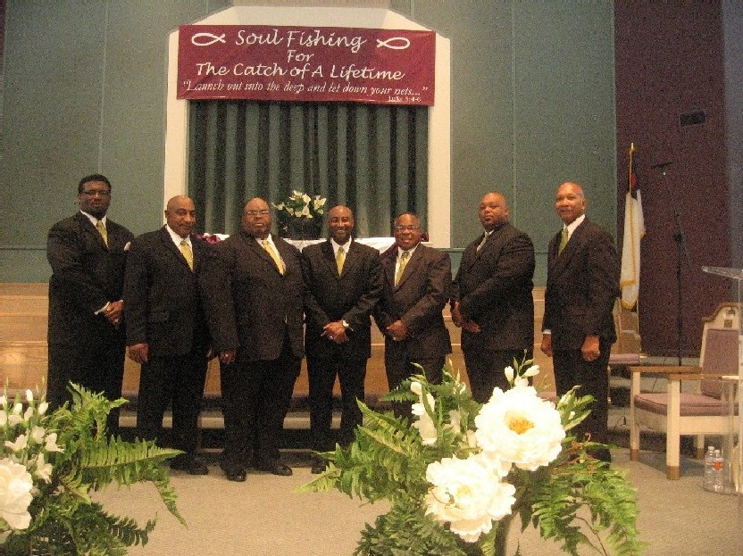
Embrace The Vision?
Step up to the plate…
Get Connected by Exalting the Savior - Worship
Get Connected by Empowering the Saints - Discipleship
Get Connected by Evangelizing the Sinner - Evangelism
Get Connected by Embracing the Saints - Fellowship
Get Connected by Empowering the Suffering – Ministry
Notes:
SLIDE #1
This first slide that I am sharing with you provides how we see this position along with our initial focus to support the Governor’s Community & Faith-Based Initiatives Program aligned with the TEA Board mission.
Our mission of course is focused on the low-income population that is designated as TEA eligible and/or customer (client). The current services available, number of TEA customers, types of social services offered by FBOs/CBOs, and the effectiveness of services to impact welfare recipients/eligible population is prompting us to be innovative in our approaches in the following general areas to:
1. Expand resources of acceptable FBO providers for Social Services in the local community
2. Enhance capacity of smaller FBOs and their capital to continue as services providers
3, and, Engage FBOs to partner with us (Government) to eliminate poverty through collaborative efforts by addressing the physical and social infrastructure within our low-income communities and promoting self-sufficiency for our target population.
We hope that in outlining this broad focus for this position, the TEA Board will be able to initiate a Faith-Based Initiative Strategy which will be the catalyst to further promote State-wide efforts in “Embracing the Faith Factor” – our Faith-Based Organizations in our local communities to eradicate poverty on all fronts. They continue to be the pillars of strength and vital link in meeting the needs of the poor with HOPE and LOVE.. It is our belief that by embracing the Faith Community we enlist that necessary component of Compassionate Care in services towards our goal of transitioning individuals from “Welfare to Work”.
TRANSITION: Now I would like to invite your attention to this next slide. This slide is designed to give you the “Big Picture” of what we see as the “Playing Field” to promote a successful Faith-Based Initiative Strategy in support of the TEA Board charter.

Slide 20
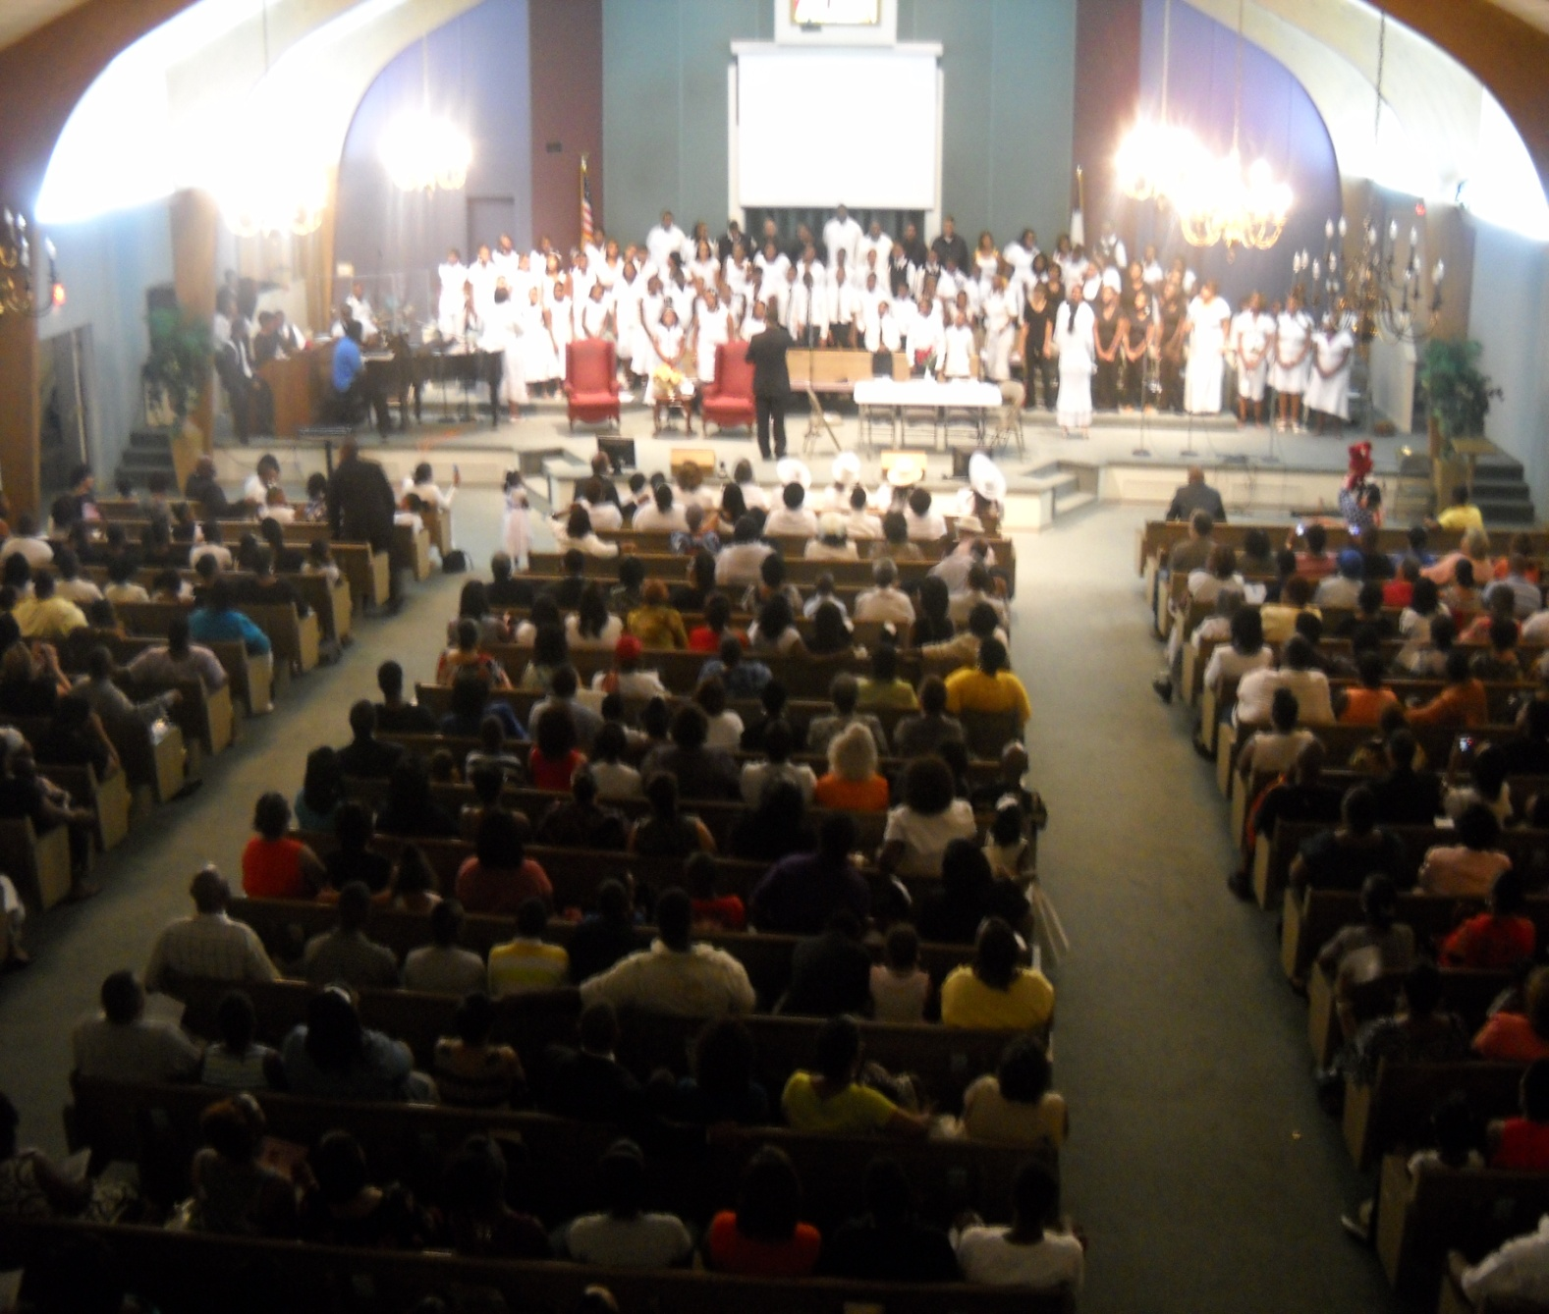
First Baptist Church
Conquering Communities for Christ
“I can do all things through Christ who strengthens me.”
Philippians 4:13

Slide 21
Embrace The Vision
Get Connected
Our Mission Statement
We seek to Conquer Communities for Christ by taking the Word of God to the Communities that lives may be transformed by the power of God.

